Slide 1
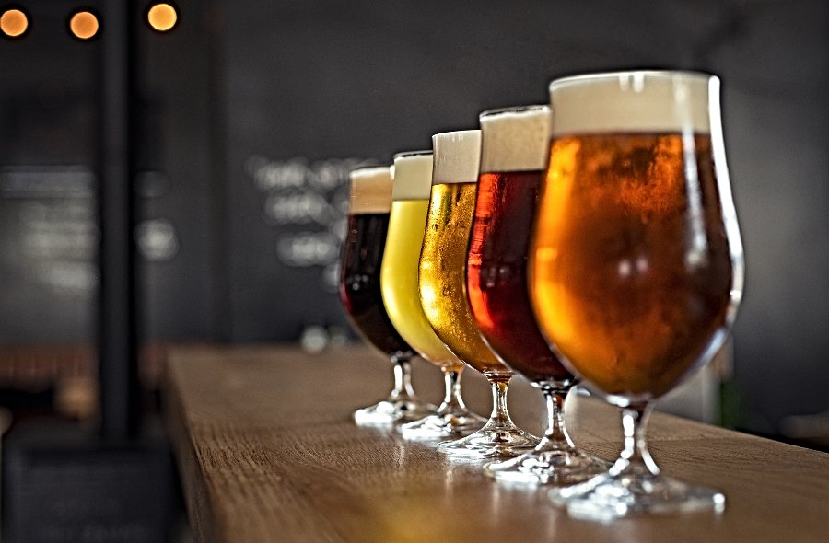
Beer Recommendations
Craig Lynch
September 9th, 2021

Slide 2

About Me
B. Eng (Mechanical) - Memorial University of Newfoundland
World Traveler
Homebrewer

Slide 3
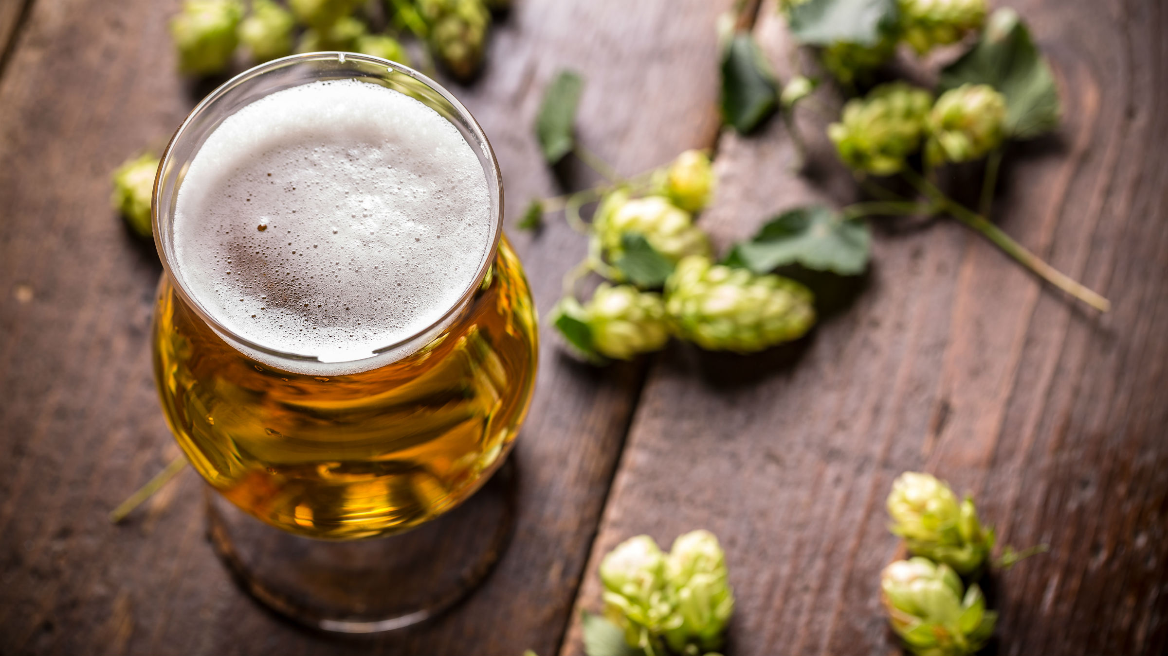
Beer Industry
Global Market Value is expected to rise to $685 billion (USD) by the year 2025 ⁽¹⁾
Number of breweries in Canada has increased from 380, in 2013, to 1,210, in 2020 ⁽²⁾

Slide 4
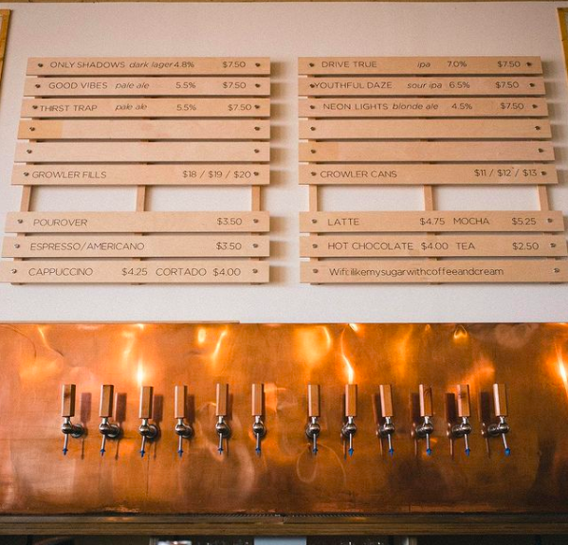
Project Goal and Business Case
Provide beer recommendations for users of Beer Advocate’s beer review site⁽³⁾
Introduce users to new breweries and beer
Develop brand and product awareness
Increase user engagement in Beer Advocate’s website and with new breweries and beer

Slide 5
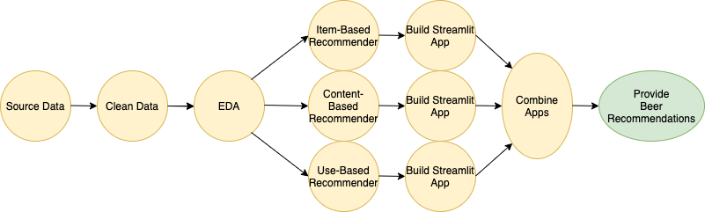
Project Flowchart

Slide 6
Exploratory Data Analysis

Slide 7
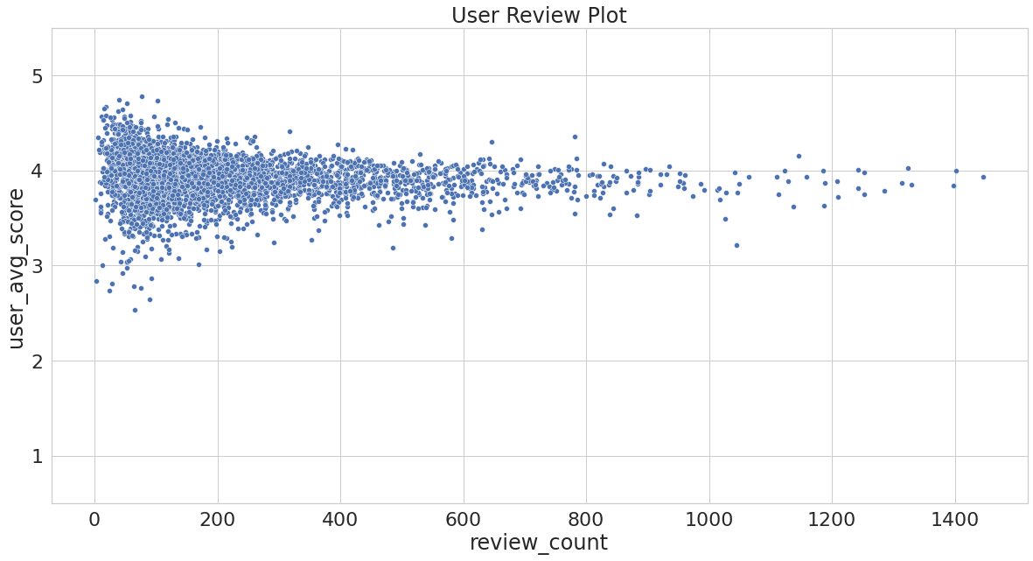
Understanding the data

Slide 8
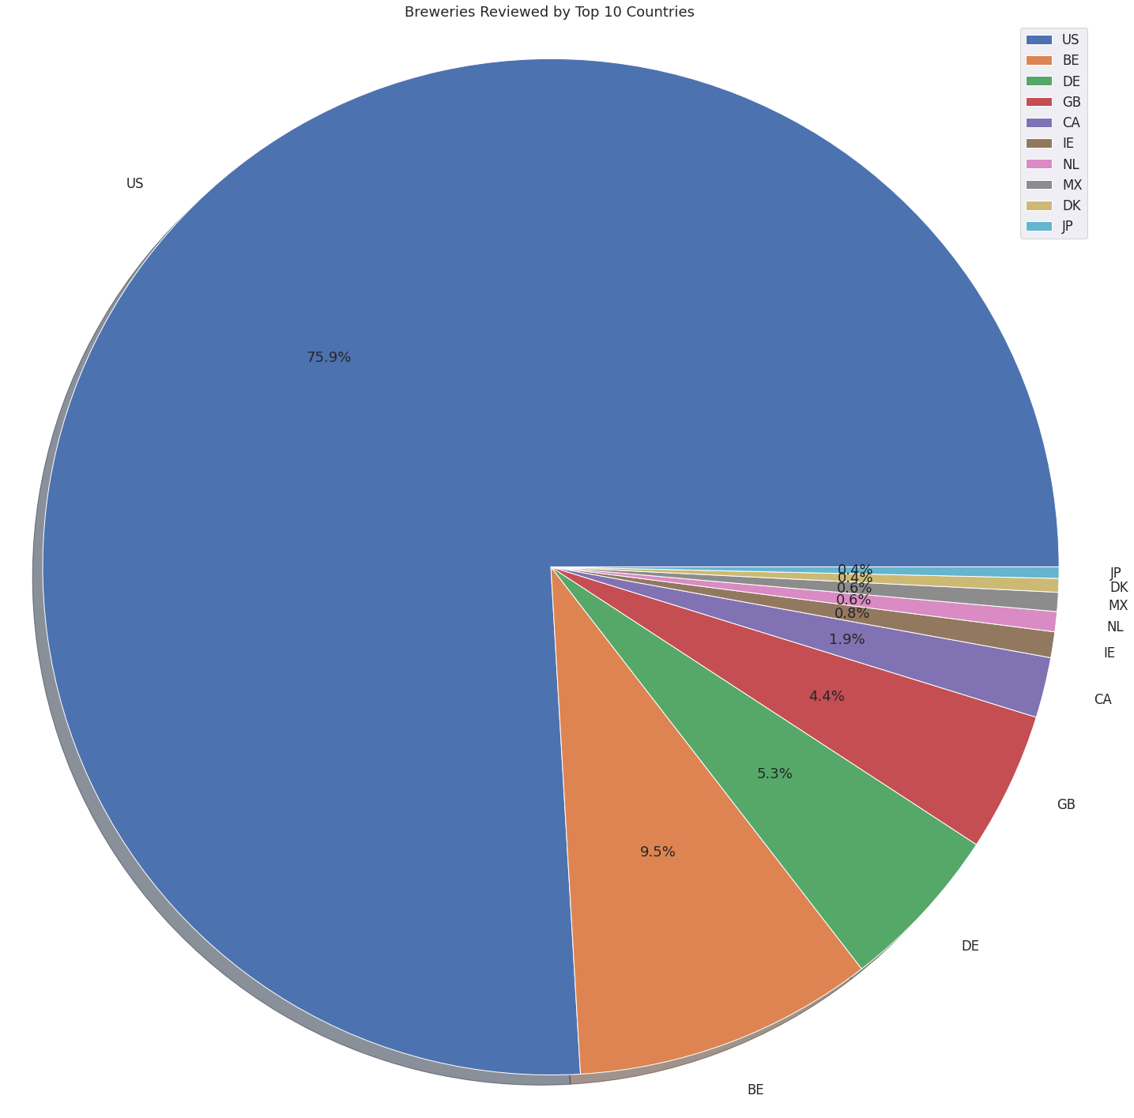
Understanding the data
Country | Percentage of Reviews
United States | 75.9%
Belgium | 9.5%
Germany | 5.3%
Great Britain | 4.4%
Canada | 1.9%
Ireland | 0.8%
Netherlands | 0.6%
Mexico | 0.6%
Denmark | 0.4%
Japan | 0.4%

Slide 9
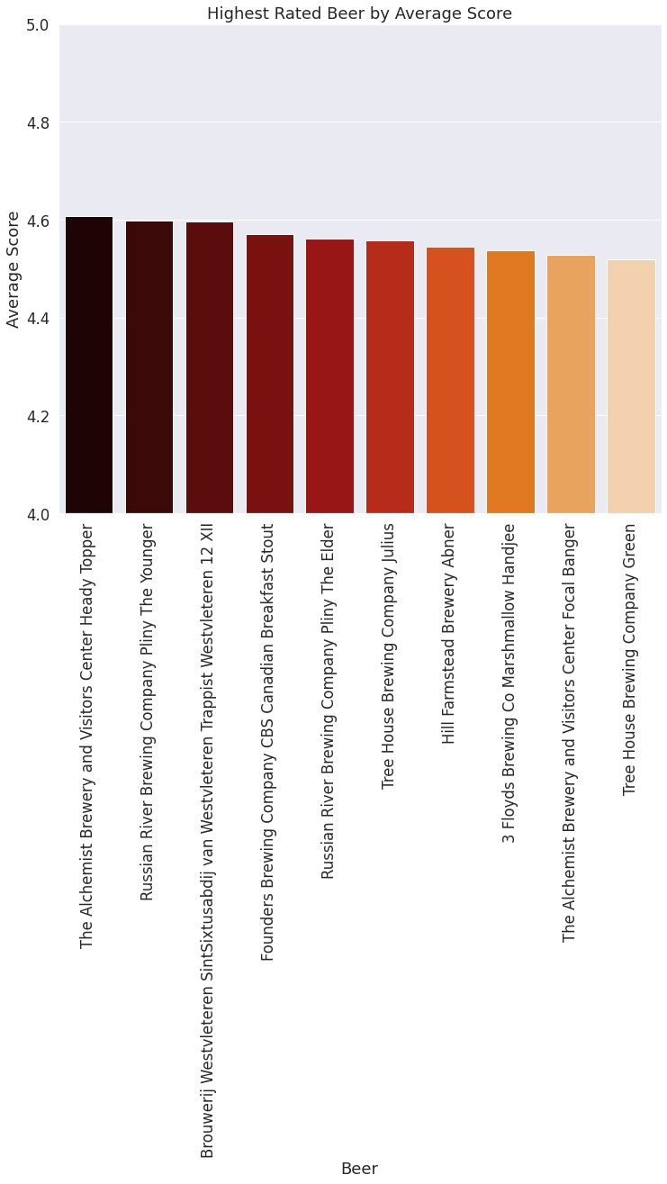
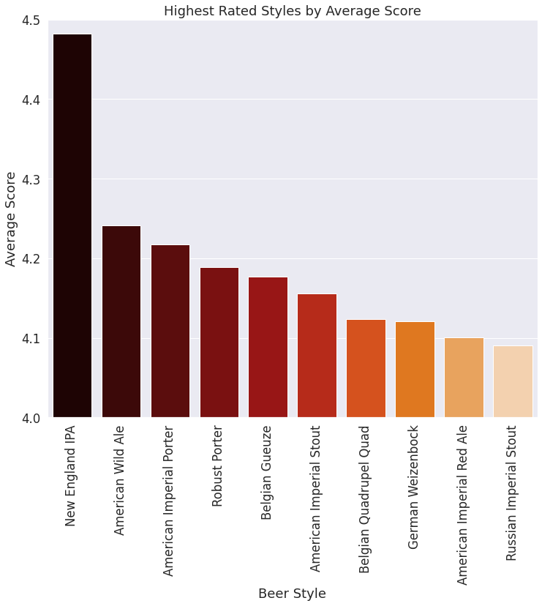
Understanding the data

Slide 10
Recommendation Systems

Slide 11
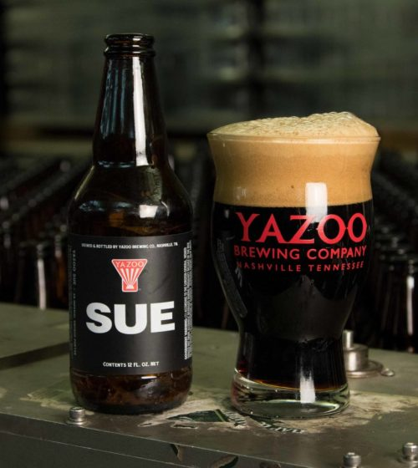
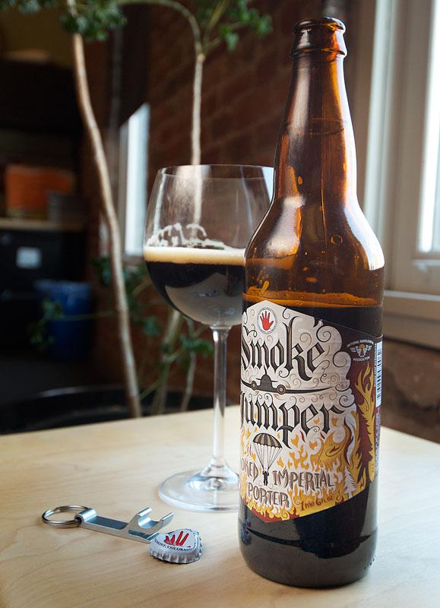
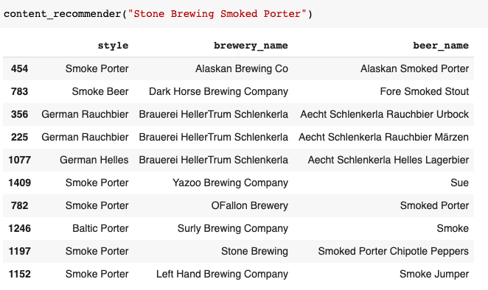
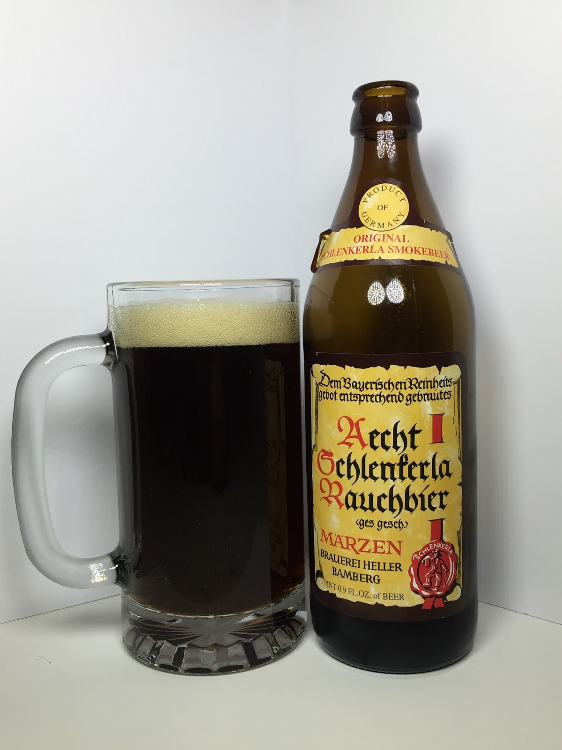
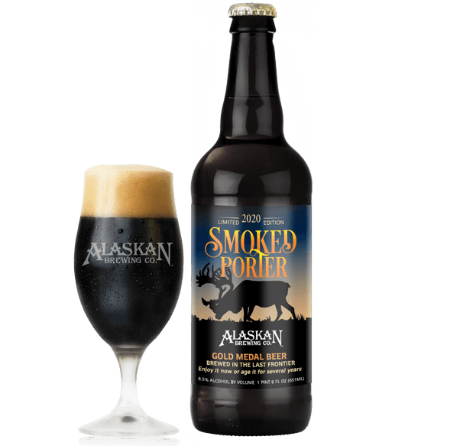
Content-Based Recommendations
Using natural language processing to find similarity in the user text reviews

Slide 12

Item-Based Collaborative Filtering

Slide 13
User-Based Collaborative Filtering

Slide 14
Moving Forward

Slide 15
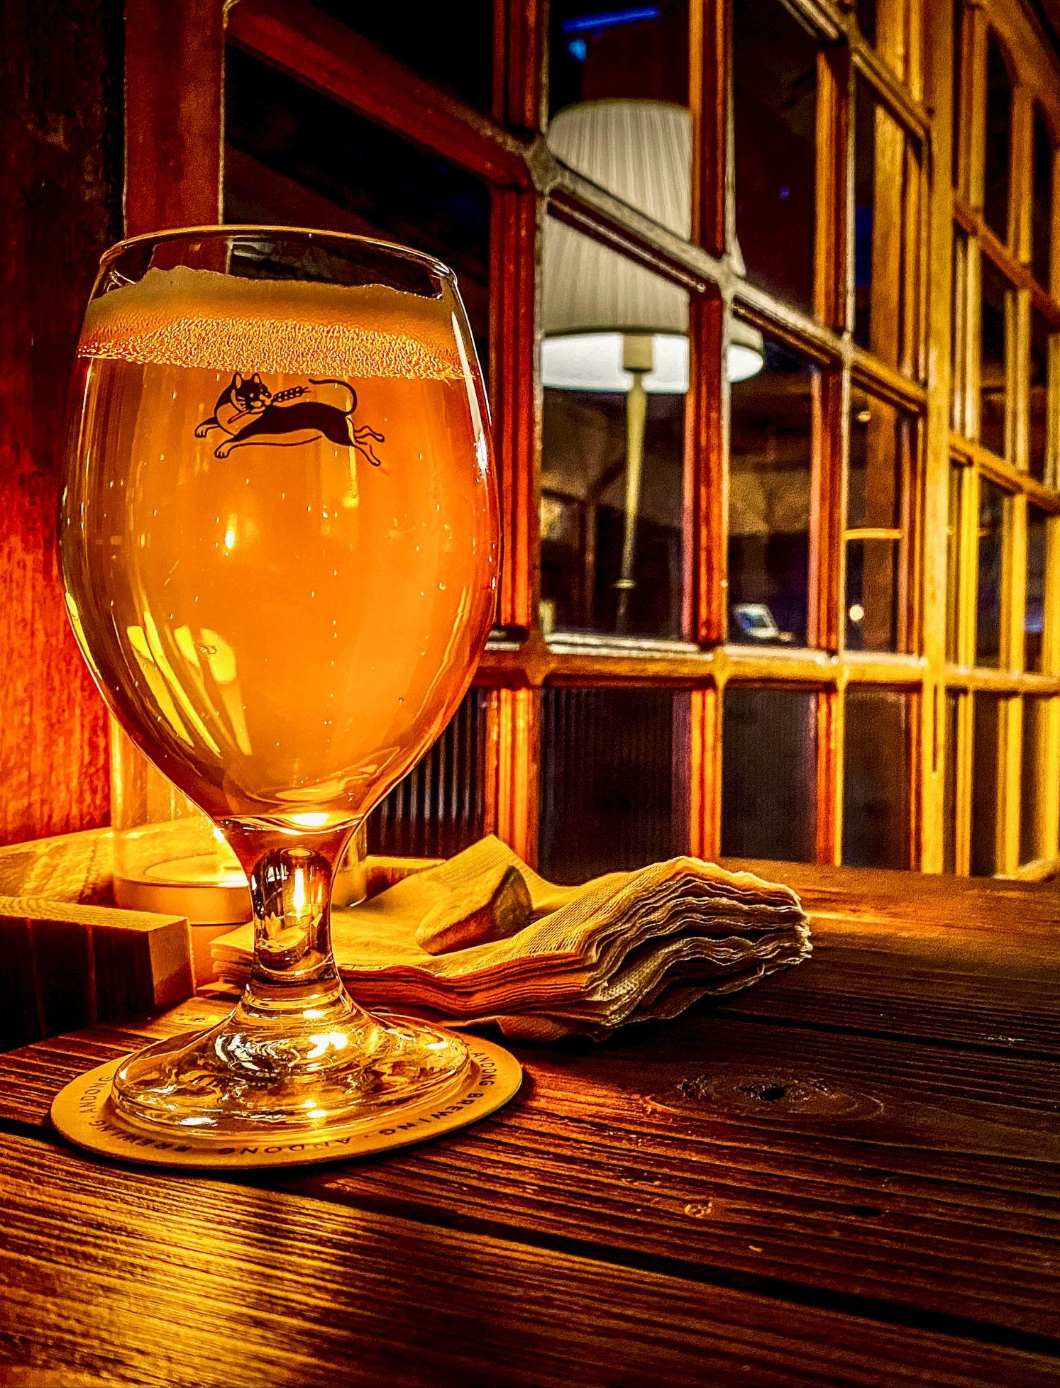
Challenges and Moving Forward
Challenges
Users with few reviews did not have enough data to make accurate recommendations
Similarly, beer with few reviews did not have enough data to include during modeling
Moving Forward
Obtain an up to date dataset, to include more recently produced beer
Have a country-specific focus in order to highlight beer from a particular country
Notes:
My initial assumption was to drop the loan amount as I felt they should be processed after a loan was approved. However, after speaking with a mentor it was decided to keep them in

Slide 16
Thank You

Slide 17
References
Data
Code References
(1) - https://www.alliedmarketresearch.com/beer-market
(2) - https://www.statista.com/statistics/1009623/number-of-breweries-in-canada/
(3) - https://www.beeradvocate.com/
https://www.kaggle.com/ehallmar/beers-breweries-and-beer-reviews?select=reviews.csv
https://github.com/kylemcq13/beer_recommender
https://github.com/Tyrell-DS/_Beer-Recommender
Notes:
My initial assumption was to drop the loan amount as I felt they should be processed after a loan was approved. However, after speaking with a mentor it was decided to keep them in

